Slide 1

Session -1.1 g;g]{ /f]ux? tyf PEN sfo{s|dsf] kl/ro Introduction to NCD and PEN Program
Time: 30 Min.

Slide 2

Session Objectives
By the end of session, trainee will able to explain
Define NCDs & their trend in the world and Nepal
Describe
Approach and Development of PEN program
Vision
Objective

Slide 3

Activity 1: Brainstorm, by asking the trainee
What do you understand by NCDs?
How does it differ from Communicable diseases?
What are the common NCDs they had seen & challenges faced during its management in their Health Facility?

Slide 4

Activity 2: Discuss and identify the person having disease related to NCDs among participants and their families
Step 1: List the number and relation of family members
Step 2: Disease they have (suffering from disease in the past, currently and is prone or in risk to those disease)
Step 3: Discuss whether they are in Risk or not

Slide 5

Activity 3: Interactive power point presentation on (17 min)
Introduction of NCDs
Trends of NCDs related morbidity & mortality
Introduction, vision and Objectives of PEN
PEN implementation status in Nepal

Slide 6
Presentation
g;g]{ /f]ux?sf] k/Lro

Slide 7
Introduction to NCDs:
Ps AolSt af6 csf]{ AolStdf g;g]{, ;'Id hLaf0f' dfWodaf6 gx'g] /f]u nfO{ ;fwf/0fotf g;g]{ /f]u (Non Communicable Disease-NCD) eGg] u/LG5 .
g;g]{ /f]ux¿n] nfdf] cjlw / ;fwf/0ftof ;':t ultdf k|efj kfg]{ub{5 .
Wf]/} AolQmx?sf] cNk cfo'd} d[To' x'g] tyf :jf:Yo If]qdf w]/} wg/fzLsf] vr{ u/fpg] oL /f]ux? ljZjdf k|d'v dxfdf/Lsf] ?kdf b]vfk/L/x]sf] 5 .

Slide 8
Reason in rise of NCDs
ljZjJoflks/0f, jhf/Ls/0f, hg;+Vof, cy{tGqtyf hLjgz}nLdf cfPsf] kl/jt{g nufPtsf cflb sf/0fn] ubf{ dflg;sf] hLjg / :jf:Yodf hf]lvd a9\b} u}/x]sf] 5 .
sf/0f | kl/jt{g
hg;f+lVosLo ;+qmd0f (Demographic Transition) | pd]/df a[l¢ (Increase Life Expatancy)
dxfdf/L ;+qmd0f (Epidemiological Transition) | g;g]{ /f]ux¿sf] j[l4 ( Increase in NCD as compare to CD)
;fdflhs sf/s tTjx¿df kl/jt{g (Social Determinants) | pRr hf]lvd Jojxf/df j[l4 tyf expose (Increase in High Risk Behavior and Exposure)
zx/Ls/0f / cfw'lgsLs/0fdf j[l4 (Urbanization and Modernization) | hLjg z}nL kl/jt{g (Lifestyle Change)
;+l3o ;+/rgfTds / k|0ffnL ;+qmd0f (Federalism and Structural change) | ;+3Lotf tyf lhDd]jf/ :yfgLo lgsfo (Federal and Responsible Local Authority)

Slide 9
g;g]{ /f]usf] ef/
g;g]{ /f]u nfuL ;s]kl5 hLjgko{Gt pkrf/ ug'kg]{, a9\bf] wfGg} g;Sg] :jf:Yo pkrf/sf] vr{ / JolQmsf] pTkfbglzntfdf cfpg] x|f; cflb sf/0fn] ubf{ JolQm, kl/jf/ tyf ;dfhn] cfDbfgLsf] 7"nf] lx:;f o;df vr{ ug'{k/]sf] 5 .
la/fdL, ckfËtf jf cNkcfo'd} x'g] d[To'sf] sf/0fn] v]/ uPsf jif{x¿ -Disability adjusted life year-DALY_ df ;a}eGbf 7"nf] cg'kft -%!%_ g;g]{ /f]ux¿nsf] sf/0fn] ubf{ of]ubfg x'g] ub{5 (NCDI report) .
g;g]{ /f]ux?sf] pkrf/sf] vr{sf] sf/0fn] aif]{gL xfd|f] h:tf] b]zdf y'k|} 3/k/Ljf/ u/Llasf] /]vfd'gL ws]lnPsf 5g\ . g;g]{ /f]ux?n] /f]usf] ?kdf dfq g/xL ;fdflhs, cfly{s, jftfj/0fdf / ;du| b]z ljsf;df g} ;d]t gsf/fTds c;/ kfl//x]sf] x'G5 .

Slide 10
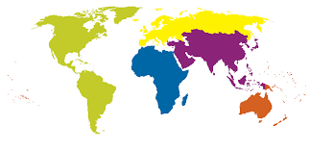
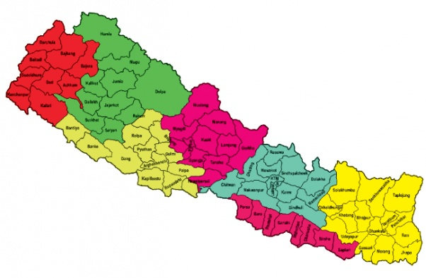
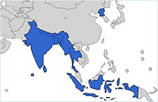
g;g]{ /f]usf] k|sf]k
g;g]{ /f]usf sf/0f jif]{lg laZjdf sl/a $ s/f]8 !) nfv dflg;sf] d[To' x'g] ub{5 .
lt d[To' dWo] ;a}eGbf a9L ! s/f]8 &( nfv CVDs ;+u, () nfv Sofg;/ ;+u, #( nfv Zjf;k|Zjf; ;+u / !^ nfv dw'd]x ;DalGwt ePsf] lyof] .
g]kfndf (WHO Country profile 2018 cg';f/_ ePsf] s'n d[To' dWo] ^^ k|ltzt d[To'sf] sf/0f g;g]{ /f]uaf6 ePsf] lyof] .
g]kfn nufot blIf0fk"jL{ Pl;ofsf b]zx¿df k|d'v g;g]{ /f]u, ljif]z u/L #) b]lv &) jif{ pd]/ ;d"xsf dflg;x¿df,cNkfo'd} d[Tosf] -@@ k|ltzt_ k|d'v sf/0fsf] ?kdf b]lvPsf] 5 .

Slide 11
g]kfndf x'g] laleGg g;g]{ /f]ux?sf] ca:yfx? -k|ltztdf_

Slide 12
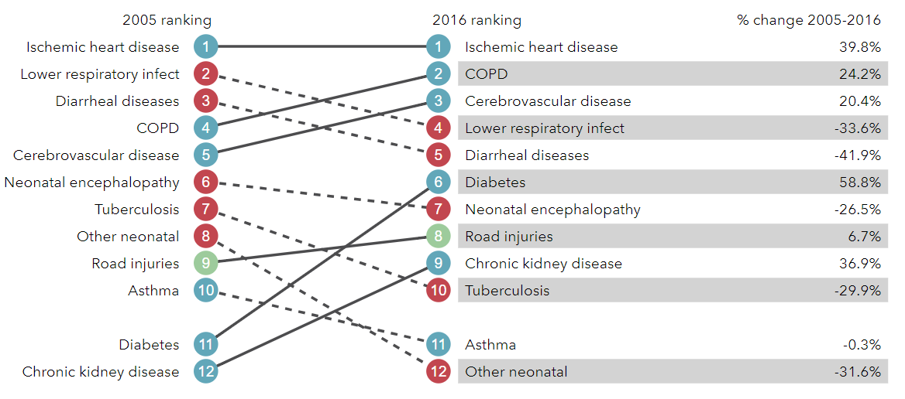
g;g]{ /f]ux?sf] bfhf]df g;g]{ /f]ux?sf] ca:yfx? (Trend)
(Source: Global Burden of Disease, 2016)

Slide 13
Presentation
k|d'v g;g]{ /f]ux? /f]syfd tyf lgoGq)f k|of;

Slide 14
k|d'v g;g]{ /f]ux? /f]syfd tyf lgoGq0f k|of;
ljZj :jf:Yo ;+u7gsf] ^% cf}F dxf;efdf ;b:o /fi6«n] g;g]{ /f]usf sf/0fn] x'g] cNkfo' d[To' ;g\ @)@% ;Dddf @% k|ltztn] 36fpg] nIo lnPsf] 5 .
To;}u/L lbuf] lasfz nIon] ;d]t Ps ltxfO{n] g;g]{ /f]usf sf/0fn] x'g] d[To' 36fpg] nIo lnPsf] 5 .
;f] nIo k|flKtsf lglDt, ;b:o /fi6«n] laleGg cjwf/0fnfO{ cl3 ;f/]sf 5g\ h:t} /0flgtLs sfo{ of]hgf agfpg], ljZj :jf:Yo ;+u7gsf PEN cawf/0ff nfO{ nfu' ug]{ tyf “BEST BUYS” sf] cjwf/0ff ckgfpg] /x]sf 5g\ .
o; tYonfO{ Wofg lbb} g]kfn ;/sf/n] NCD sf] /f]syfd / lgoGq0fsf nflu gLltut, /0flgltut laleGg of]hgf tyf sfo{s|d nfu' u/]sf] 5 .

Slide 15
k|d'v g;g]{ /f]ux? /f]syfd tyf lgoGq0f k|of;
gLltut
/fli6«o :jf:Yo gLlt @)&!
/fli6«o dfgl;s :jf:Yo gLlt @)%#
/fli6«o d'v :jf:Yo gLlt @)&! cflb
/0flgltut
National Health Sector Strategy -NHSS (2016-2020)
Multi Sectoral Action Plan for Prevention and Control of NCD (2014-2020)
k|fylds :jf:Yo ;]jf :t/sf sfo{s|dx?
Package of Essential Non Communicable Disease (PEN) Intervention
mhGAP for Mental Health

Slide 16
k|d'v g;g]{ /f]ux? /f]syfd tyf lgoGq0f k|of;
g]kfn ;/sf/n] cg'df]bg u/]sf] g;g]{ /f]u /f]syfd tyf lgoG`0f ;DaGwL ax"If]qLo sfo{ of]hgf @)!$−@)@) cg';f/ ;g\ @)@% ;Dd xfl;n ug'{kg]{ !) nIox¿
;d|udf dw'd]x, d'6'/f]u,SofG;/ tyf bL3{ Zjf;k|Zjf; ;DaGwL /f]ux¿af6 x'g ;Sg] d[To'nfO{ @%% n] sd ug]{ .
dBkfgsf] xflgsf/s ;]jgnfO{ @%% n] sd ug]{ .
!% jif{ eGbf dflysf AolQmx¿df ;'lt{hGo kbf{ysf] k|of]udf #) % n] sd ug]{ .
Vffgf ksfpg k|of]u x'g] k|d'v ?kdf 7f]; OGwgsf] (Solid fuel) k|of]u b/nfO{ %) % n] sd ug]{ .
s'n hg;+Vofdf g'gsf] cf}ift k|of]ub/nfO{ #) % n] sd ug]{
pRr /Qmrfksf] ;d:ofnfO{ @%% n] sd ug]{ .
dw'd]x / df]6f]kgfsf] a9b} uO/x]sf] ;d:ofnfO{ /f]Sg] .
ckof{Kt zf/Ll/s s[ofsnfk ;d:ofnfO{ !) % n] sd ug]{ .
x[bo3ft, dl:ts3ft tyf /utdf lrlgsf] dfqf lgoGq0fsf lglDt cf}iflw / k/fdz{ cfjZos dWo] slDtdf %)% nfO{ cf}ifwL pkrf/ tyf k/fd{z lbg] .
g;g]{ /f]usf] pkrf/sf lglDt cfjZos k|ljlwnfO{ ;/sf/L tyf lghL c:ktfn u/L sDtLdf *)% k'¥ofpg] .

Slide 17
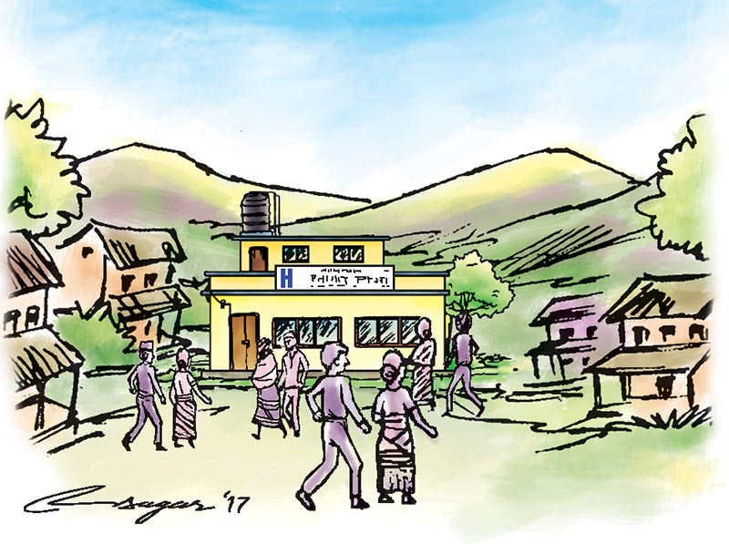
Presentation
Package of Essential Non Communicable (PEN) Disease Programme

Slide 18
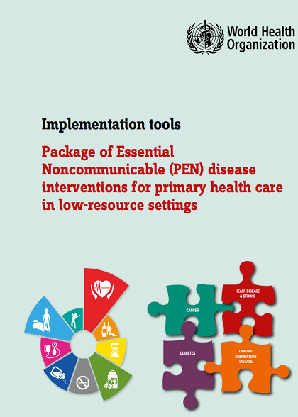
PEN sfo{s|d
;d'bfodf n's]/ /x]sf tyf gb]lvPsf la/fdLx¿sf] ;dodf g} lgbfg u/L ;lx pkrf/ tyf Aoj:Yffkgsf] bfo/fdf Nofpgsf] nfuL g]kfn ;/sf/n] g;g]{ /f]u ;DaGwL sfo{s|d ;~rfngdf NofPsf] xf] .
g]kfn ;/sf/n] g;g]{ /f]usf] pkrf/ ;zSt ?kdf cl3 a9fpg ljZj :jf:Yo ;+u7gsf] PEN cjwf/0fnfO{ cg'df]bg u/L nfu' u/]sf] 5 .

Slide 19

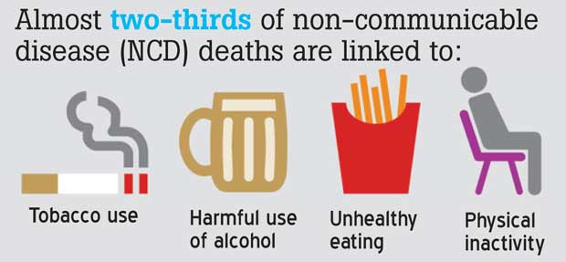
PEN sfo{s|d
PEN sfo{s|dn] k|d'v ?kdf
k|d'v $ g;g{] /f]ux¿sf] M
d'6' tyf /QmgnLsf] /f]u,
dw'd]x,
lb3{ ZjfZk|Zjf; ;DaGwL /f]u /
SofG;/ -:tg / kf7]3/sf] d'v_ sf] /f]syfd, lz3| lgbfg, Joj:yfkg / k|]if0f
oL g;g{] /f]usf $ k|d'v sf/s tTjx¿sf]
zf/Ll/s lgl:s|otf
w'd|kfg
dBkfgsf] k|of]u
c:j:y vfgkfg

Slide 20
WHO PEN Envision
Vision (b[li6) :
g;g{] /f]u nfu]sf dflg;x?sf nflu k|efjsf/L tyf ;dtfd"ns tyf /f]syfd, pkrf/ tyf x]/rfx
Goals -nIo_:
k|d'v g;g{] /f]usf] sf/0faf6 x'g] ef/ ;fdflhs, cfly{s ef/nfO{ tyf dfgljo b'Mv nfO{ sd ug{sf lglDt cTofjZos pRr u'0f:tl/o lgbfg tyf pkrf/sf] ;]jfsf] kx'FrnfO{ a9fpg]
ul/a tyf pRr hf]lvddf /x]sf dflg;x?nfO{ d'6' /f]u, kIf3ft, pRr /Strfk SofG;/ dw'd]x, bd cflb /f]ux?af6 arfpg] .
k|fylds ;]jf 4f/f ;f] /f]ux?sf] k|efjsf/L tyf ;|f]tn] Eofpg ;Sg] /f]syfd tyf pkrf/ k|bfg ug'{ .

Slide 21
PEN sfo{s|d
PEN sfo{s|dsf] pb]Zox?
g;g]{ /f]usf] pkrf/df Ps?ktf .
g;g]{ /f]usf] ;dod} u'0f:tl/o lgbfg, pkrf/ tyf Joj:yfkg .
g;g]{ /f]usf sf/0fx¿sf] /f]syfd tyf lgoGq0fsf nflu k/fdz{ .
:jf:Yo ;+:yf, lawfno / ;d'bfo ljr ;dGjodf j[l¢ .
;j{JofkL :jf:Yo ;]jfdf (Universal Health Coverage) ;dtfd"ns kx'r tyf sfo{bIftf a9fpg] .

Slide 22
PEN sfo{s|d
PEN k|f]6f]snsf] pkrf/ tyf Joj:yfkg If]q
g]kfn ;/sf/n] PEN k|f]6f]sn !, @, # / $ nfO{ cg'df]bg u/]sf] 5 .
k|f]6f]sn ! | d'6' tyf /QmgnLsf] /f]u / dw'd]xsf] Plss[t Aoj:yfkgsf] dfWod af6 Åbo3ft, dlit:s3ft / d[uf}nf /f]ux?sf] /f]syfd (Prevention of Heart Attack, Strokes and Kidney Disease through Integrated Management of Diabetes and Hypertension)
k|f]6f]sn @ | :j:Yf hLjgz}nLsf] af/]df :jf:Yo lzIff tyf k/fdz{ Health Education and Counselling on Healthy Behaviours
k|f]6f]sn # | #=! bd /f]usf] Joj:yfkg (Management of Asthma) #=@ bL3{ Zjf;k|Zjf; ;DaGwL /f]usf] Joj:yfkg (Management of Chronic Obstructive Pulmonary Disease -COPD)
k|f]6f]sn $ | $=! :tg :jf:Yosf] klxrfg / k|f/lDes cj:yfd} ;+efljt :tg SofG;/sf] k|]if0f . (Assessment of Breast Health and Referral of Women with Suspected Breast Cancer) $=@ klxrfg / k|f/lDes cj:yfd} ;+efljt kf7]3/sf] d'vsf] SofG;/sf] k|]if0f . (Assessment and Referral of Women with Suspected Cervical Cancer)

Slide 23
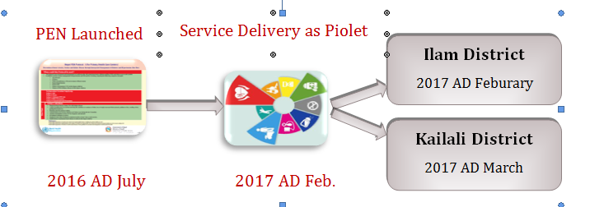
PEN sfo{s|d
PEN sfo{s|dsf] z'?jft

Slide 24
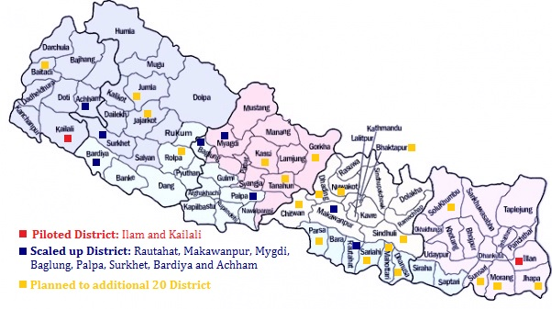
PEN sfo{s|d
Coverage of PEN Programme
cfufld aif{x?af6 af6 of] sfo{qmd b]zsf] && lhNnfdf k"/\ofpg] of]hgf ;d]t /x]sf] 5 .

Slide 25
Implementing Task Sharing at Primary Health Care Setting
High risk only those person who visited in HF with suspected disease
Team based care
HP
Screening and referral by paramedic
Refilling of drugs
Referral for Refilling of Drugs
PHCC
Diagnosis and treatment by Medical Officer
Referral
District Hospital
Diagnosis and treatment by Medical Officer
Referral
Not specific management of referral and not developed protocol and program for this level
Tertiary Hospitals
Diagnosis and treatment by Medical Officer
Referral

Slide 26
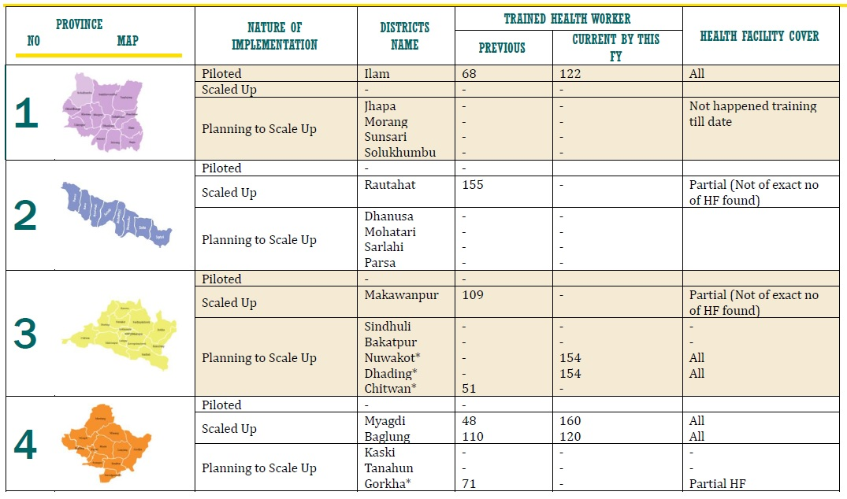
Province wise Service Strengthen The total number of health workers trained as per piloted, scaled up and planning to scale up District of seven Province of Nepal

Slide 27
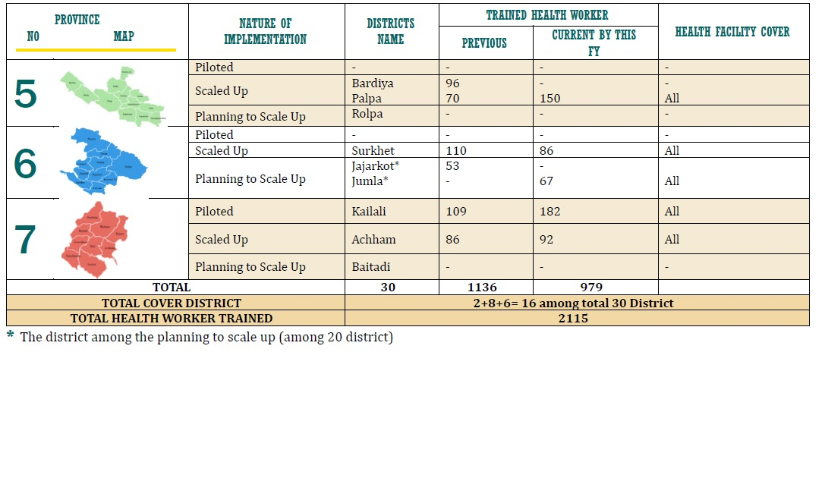
Province wise Service Strengthen Contd…….

Slide 28
Summarize
Derive the session conclusion with communication with participants

Slide 29



Any Confusion

Slide 30


